Slide 1
A Recommendation System for Groceries Contractor
Capstone Project - The Battle of Neighborhoods
Samantha Toh

Slide 2
Introduction
Problem Description
A groceries contractor in one of the boroughs of Toronto (Scarborough) provided different restaurants, bakery, breakfast spot, brewery and café with fresh and high-quality groceries. The contractor wanted to construct a warehouse for the groceries it buys from villagers and farmers inside the borough, so that they will support more customers and also bring better quality of service to the existing customers.

Slide 3
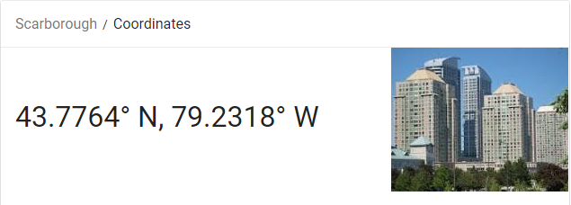
Data
We need the geo-locational information about that specific borough and the neighborhoods in that borough. We assume it is Scarborough in Toronto. This is easily provided for us by the contractor as he has already made up his mind about the borough.

Slide 4
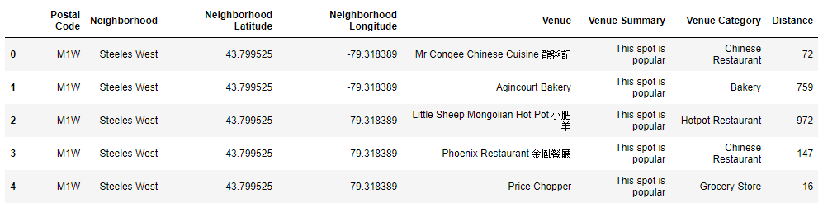
We will need data about different venues in different neighborhoods of that specific borough. In order to gain that information, we used Foursquare locational information. A typical request from Foursquare will provide us with the following information:

Slide 5
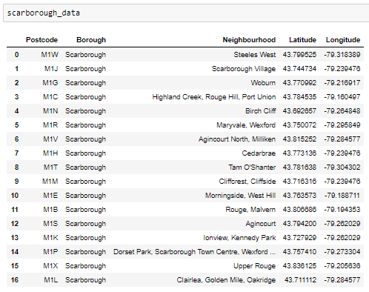
Methodology
1. Identifying Postal Codes (and then Neighborhoods) in Scarborough

Slide 6
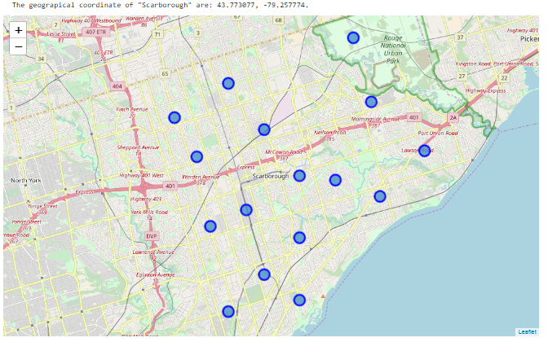
Cont’

Slide 7
2. Connecting to Foursquare and Retrieving Locational Data for Each Venue in Every Neighborhood
After identifying the list of neighborhoods, we then connected to the Foursquare API to gather information about venues inside each and every neighborhood. For each neighborhood, we have chosen the radius to be 1000 meter, implying we have asked Foursquare to search for venues that are at most 1000 meter far from the center of the neighborhood.

Slide 8
3. Processing the Retrieved Data and Creating a DataFrome for All the Venues inside the Scarborough
When the data is completely gathered, we processed the raw data to identify our desirable features for each venue. Our main feature is the category of that venue. After this stage, the column “Venue's Category” was One-hot encoded and different venues will have different feature-columns. After On-hot encoding we integrated all restaurant columns to one column “Total Restaurants” and all food joint columns to “Total Joints” column.

Slide 9
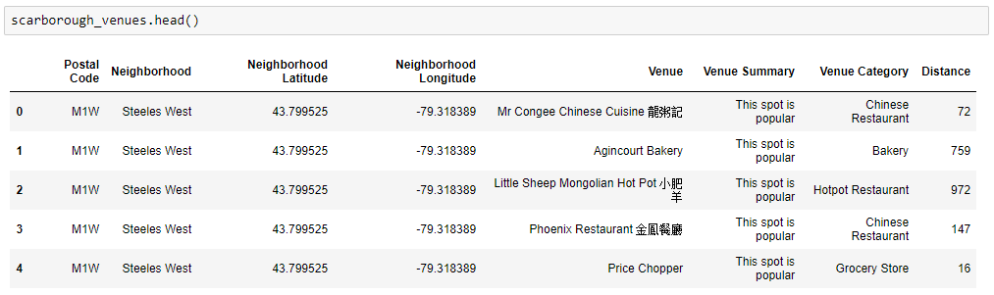
Cont’

Slide 10
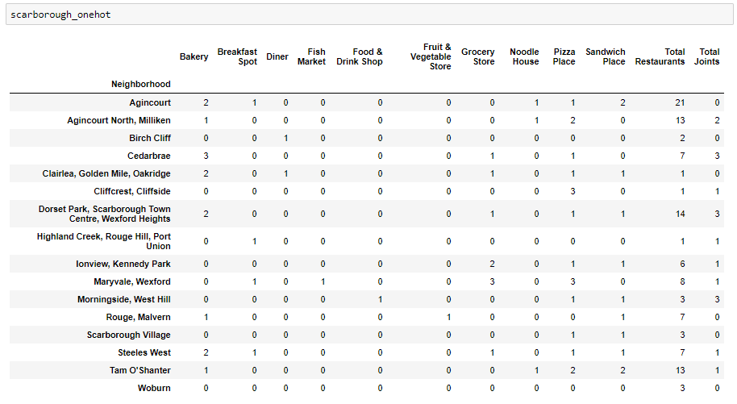
The dataset is now ready to be used for machine learning (and statistical analysis) purposes.

Slide 11
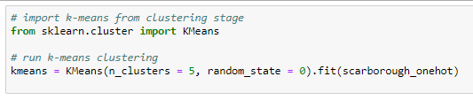
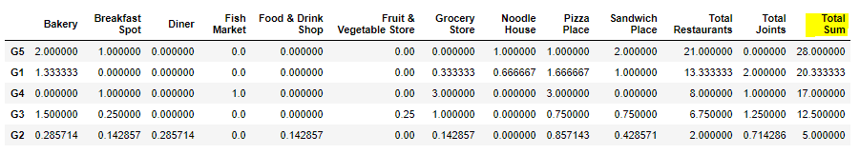
4. Applying one of Machine Learning Techniques (K-Means Clustering)

Slide 12
Results
We focused on the centers of clusters and compare them for their “Total Restaurants” and their “Total Joints”. The group which its center has the highest “Total Sum” is our best recommendation to the contractor.
{Note: Total Sum = Total Restaurants + Total Joints}
This algorithm although is pretty straightforward yet powerful.

Slide 13
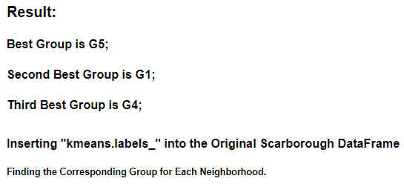
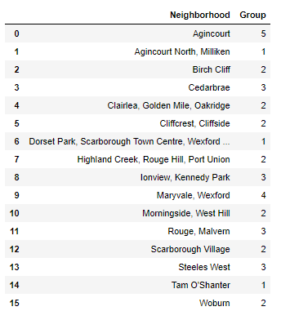
Cont’

Slide 14
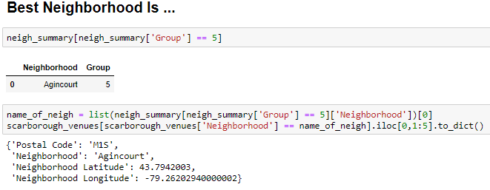
Cont’
According to the analysis results, the optimal recommended neighborhood is: {'Neighborhood': 'Agincourt', 'Postal Code': 'M1S', 'Neighborhood Latitude': 43.7942003, 'Neighborhood Longitude': -79.26202940000002}

Slide 15
Conclusion
We have identified the best recommended neighbourhood for the contractor, in the hope that he will be benefited from this.

Slide 16
Thank you

